Slide 1


Infosys Springboard virtual internship
AIRFLY INSIGHTS: AIRLINE DATA VISUALIZATION
INTERN : DADI NAYANA SRI
MENTOR : PRIYA
PROJECT : FLIGHT DELAY AND CANCELLATION ANALYSIS
DATE : 06-04-2027
Batch-13

Slide 2
Problem Statement:
Airlines face frequent delays and cancellations, impacting customer satisfaction and operational efficiency.
Objective
Analyze flight data to identify delay patterns
Understand cancellation reasons
Generate actionable insights
Why This Matters
Analyze flight data to identify delay patterns
Understand cancellation reasons
Generate actionable insights

Slide 3

Dataset Overview
Source: Kaggle Airline Dataset
Size: ~3 Million records, 36 features
Key Features:Airline, Route (Origin–Destination)
Departure & Arrival Time
Delay Metrics (Carrier, Weather, NAS)
Cancellation Details
Complexity:
Large-scale real-world dataset
Missing values and inconsistent formats
Multiple delay factors

Slide 4
Project Workflow / Pipeline
Data Collection → Data Cleaning → Feature Engineering → EDA → Visualization → Insights

Slide 5
Data Preprocessing (Milestone 1)
Handled missing values in delay and cancellation columns
Converted date columns into proper datetime format
Removed inconsistencies and optimized data types
Created new features:
Month
Day of Week
Hour of Departure
Route (Origin-Destination)
Why Preprocessing?
To ensure clean, consistent, and analysis-ready data

Slide 6
Exploratory Data Analysis (EDA) (Milestone 2)
Key Observations:
Uneven distribution of flights across months
Certain airlines dominate traffic
Major airports handle high traffic
Visuals to Show:
Flights per Month
Top Airlines
Flight Distribution by Hour

Slide 7
Route & Airport Analysis (Milestone 3)
Identified top 10 busiest routes
Highlighted most delayed routes
Found busiest airports
Key Insight:
High-traffic routes experience frequent congestion
Certain airports consistently face delays
Cancellation Analysis
Analyzed cancellation codes:
Weather (highest)
Carrier issues
Security (lowest)
Observed seasonal patterns
Key Insight:
Weather is the primary cause of cancellations

Slide 8
Visual Report & Dashboard (Milestone 4)
Combined all visualizations into a structured storytelling flow
Created clear and professional charts with:
Proper titles
Axis labels
Legends
Organized analysis into sections:
Delay Analysis
Route & Airport Analysis
Cancellation Trends
Seasonal Patterns
Key Insight:
A well-structured visual report makes complex data easy to understand and actionable
Clear visualization improves decision-making for stakeholders

Slide 9
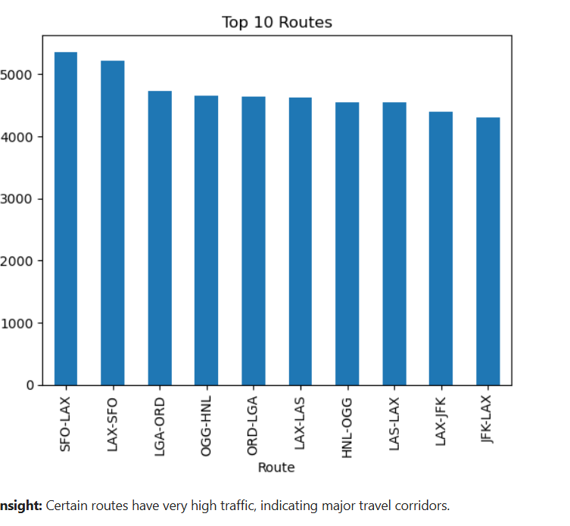
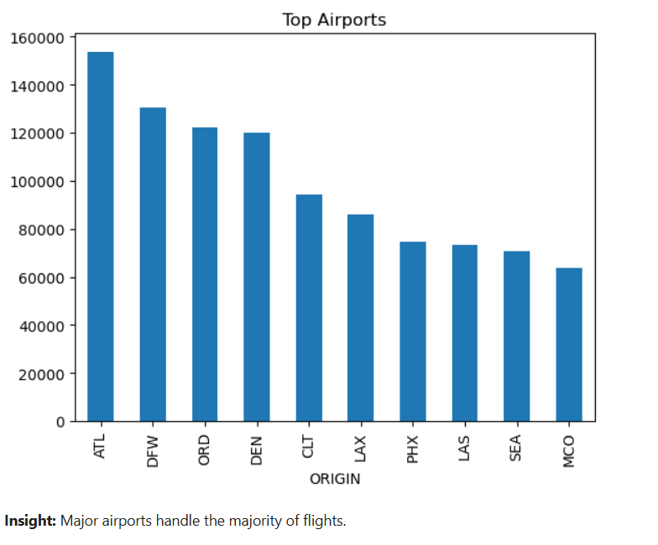

Slide 10
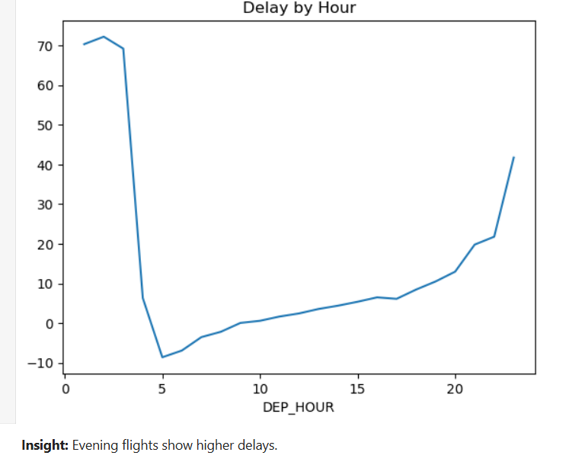
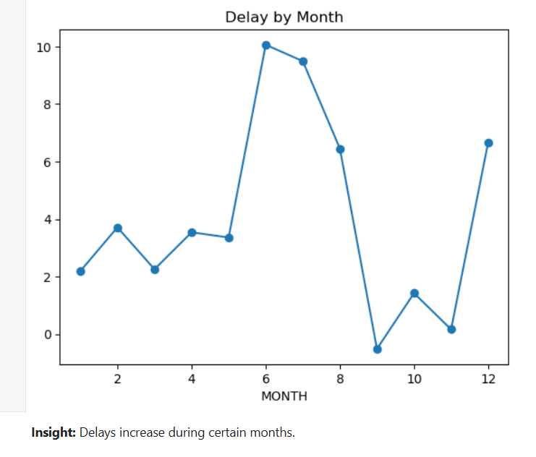

Slide 11
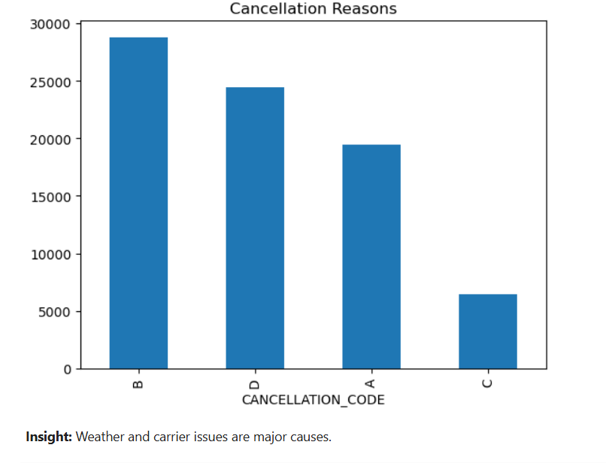

Slide 12
Final Insights & Storytelling
Integrated insights from all milestones into a single narrative
Connected patterns across:
Time (hour, month, season)
Airlines
Routes and airports
Delay and cancellation factors
Key Insight:
Combining multiple analyses reveals hidden patterns and deeper insights
Data storytelling helps transform raw data into business value

Slide 13
Overall Impact
Transformed raw airline data into meaningful insights
Identified key factors affecting delays and cancellations
Built a complete end-to-end data analysis workflow
Key Insight:
Data-driven insights can help airlines:
Optimize operations
Reduce delays
Improve passenger satisfaction

Slide 14
Thank You

